Slide 1

CSC 236
Tutorial Number 6 - Daniel Razavi

Slide 2
Sorry About Missing Last Week’s Class

Slide 3
How was Halloween?

Slide 4
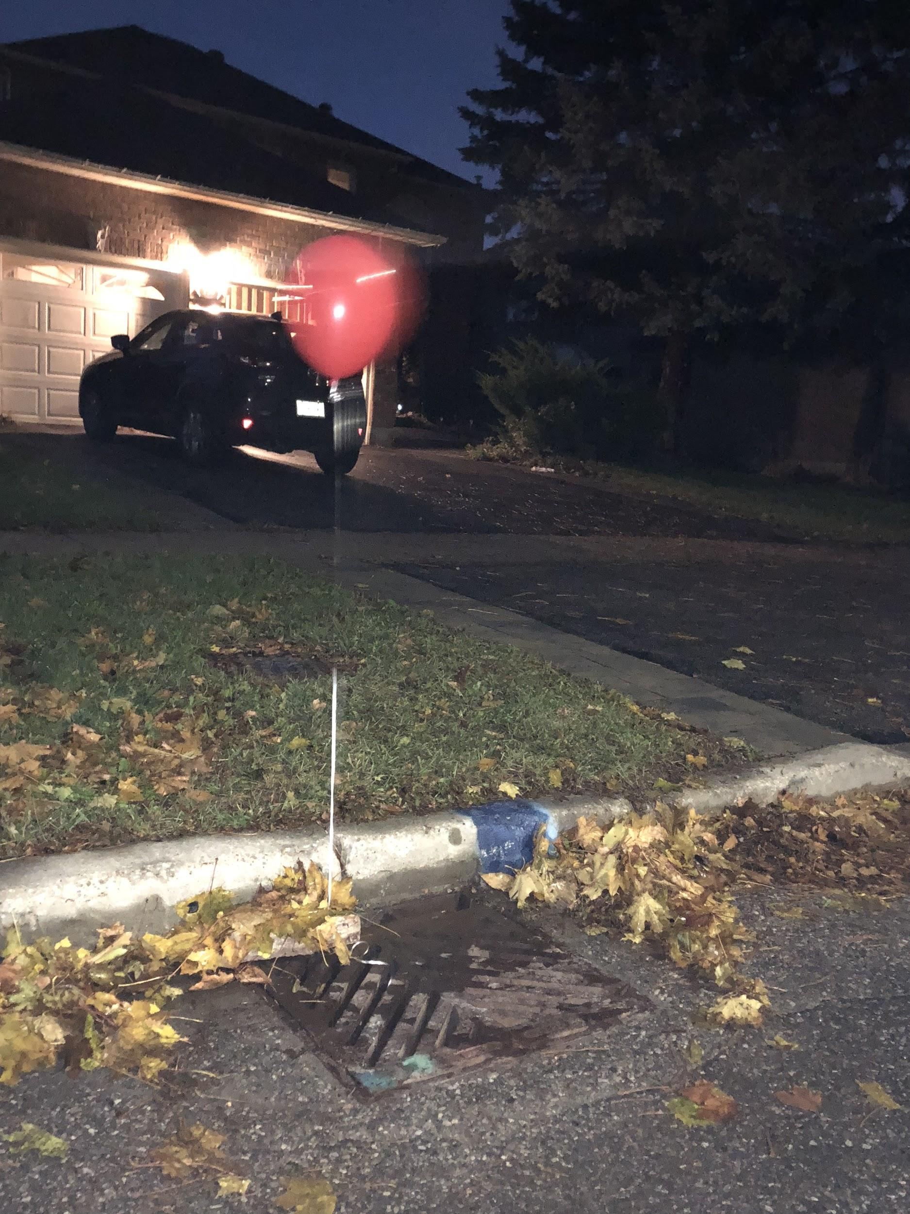

Slide 5
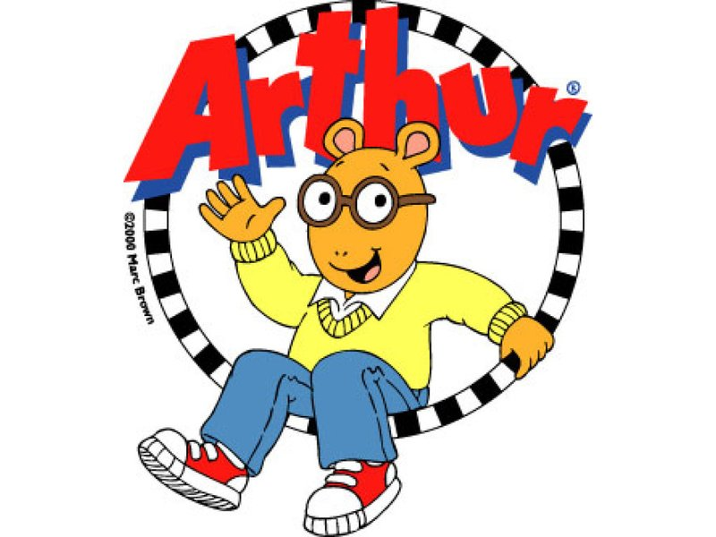

Slide 6
Today’s Problem Set

Slide 7
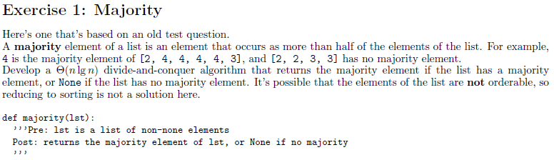
???

Slide 8
COMPETITION!!!!!

Slide 9
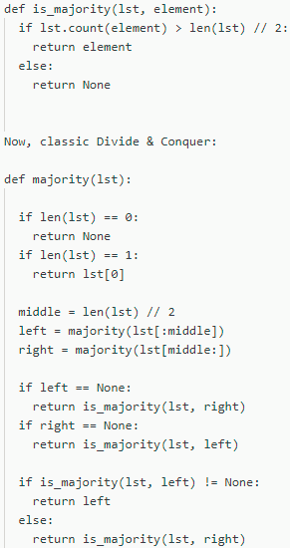
Let’s say the base case is when there are no elements in the list
Another base case is when there is only one element in the list

Slide 10
Let “middle” equal a number that can be used as the middle index of the list, regardless if the list has odd number of elements or even number of elements
Divide the list into two and recursively call “majority” on both.

Slide 11
Let “middle” equal a number that can be used as the middle index of the list, regardless if the list has odd number of elements or even number of elements
We now need to figure out what happens when we know what “left” and “right” are

Slide 12
When “left” is “None”
When “right” is “None”
When “left” is some number
When “right” is some number

Slide 13
“is_majority” checks whether if the element presented is in fact the majority element in the list
When “left” is “None”
It returns right but only if it is the majority of the right list.
When “left” is “None”
It returns “right” but only if it is the majority of the right list.
When “left” is some number, and “left” is the majority
When “right” is some number, and “right” is the majority

Slide 14
Now by taking a look at “is_majority”, we know that it has a runtime of theta(n)
“majority” function itself has a runtime of theta(log n) given that “is_majority” has runtime of 1.

Slide 15
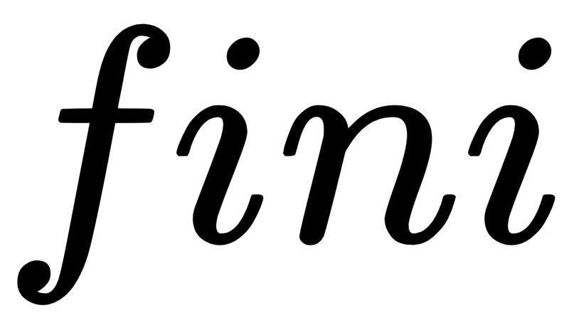
Now by taking a look at “is_majority”, we know that it has a runtime of theta(n)
“majority” function itself has a runtime of theta(n*log n) given that “is_majority” has runtime of n.

Slide 16
CSC 236
Tutorial Number 5 - Daniel Razavi

